Slide 1

THE BASICS OF SOCIAL RESEARCH
PA 604
Professor Burrel Vann Jr

Slide 2


How do we know if/why something exists?
QUESTION
Is it cold on the dark side of the moon?
Does racism exist?
Does protest influence political change?

Slide 3

METHODOLOGY
Science of finding out if something exists
Notes:
Epistemology: The science of knowing

Slide 4


OBSERVATION
EXPLANATION

Slide 5
Empirical Scientific Inquiry
Observations
Explanations
Direct:
You conduct observations of society
Indirect:
Others conduct observations of society
You develop reasons, a theory, an explanation for the patterns you see in the observations
Notes:
Others’ (for their Indirect observations)
Authority helps scientists accept new knowledge – we’re more likely to believe new discoveries based on the status of the discoverers (we’ll believe new findings about kissing and the common cold from an epidemiologist than our uncle). But problems include 1) we must accept that even specialists can make errors, and 2) we can only trust the authority of a person within their given field of expertise (we can’t trust a pastor for his proclamation about the negative neurochemical effects of marijuana).

Slide 6

Statements about if/why something exists must be both empirical and logical
EMPIRICAL SCIENTIFIC INQUIRY

Slide 7
EMPIRICAL OBSERVATIONS
verifiable through actual measurements, data, observations
LOGICAL EXPLANATIONS
(FOR OBSERVATIONS)
makes logical sense, or is based on prior theories
Notes:
So how do we know if something’s real if we haven’t personally experienced it? We rely on agreement.
Scientists say that assertions about a reality that they have not experienced themselves have to meet certain criteria… those are that the assertion must have both LOGICAL and EMPIRICAL support: it has to make sense, and it cannot contradict actual observations.

Slide 8

"it is cold on the dark side of the moon"
EMPIRICAL OBSERVATION
actual measurements confirm the assertion/claim/expectation
EXAMPLE
LOGICAL EXPLANATION
it makes sense, since the sun isn’t shining on that side
Notes:
Why do scientists agree that it’s cold on the dark side of the moon? Well, 1) it makes sense, since the sun isn’t shining on that side and 2) actual measurements confirm the assertion/claim/expectation

Slide 9

EMPIRICAL SCIENTIFIC INQUIRY
Isn't concerned with or doesn't rely on:
Speculation
Moral judgment
Subjective preference
Debates of value
Notes:
Not concerned with debates of value (e.g. good or better)
Empirical: Are women paid less than men for the same types of work?”
Not empirical: Is racial equality good for society?

Slide 10

MASS MURDERERS: PERCEPTION VS REALITY
Why do we need empirical scientific inquiry?

Slide 11
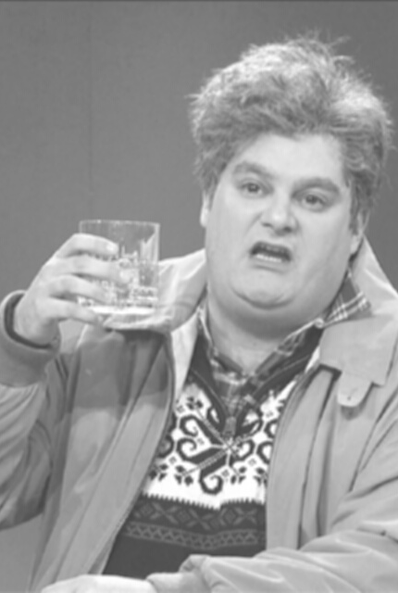
problems with
NON-EMPIRICAL, HUMAN INQUIRY
Lacks reasoning about cause & effect
Inaccurate/mistaken observations
Overgeneralizations
Illogical reasoning
Notes:
Predictions must be paired with understanding – you can’t just say that because you find that the 3rd ranked horse in the 3rd race of the day always wins, because as scientists, we must provide reasoning why it works out that way (e.g. we can’t just not care).
Inaccurate Observations – Mistakes in observations/no recall | Making deliberate observations reduces error. Measurement devices add some precision to estimates.
Overgeneralization – Observing a few similar events and assuming they’re evidence of a general pattern/overgeneralize on basis of limited observations | drawing sufficiently large samples, and replication.
Illogical Reasoning (e.g. “Gambler’s fallacy”) - the exception that proves rule – gambler on a streak of good/bad luck thinks opposite is just around the corner

Slide 12

the scientific study of society
EMPIRICAL SOCIAL SCIENCE
research methodology for understanding the social world

Slide 13

OBJECTIVITY IN EMPIRICAL SOCIAL SCIENCE
Certain topics cannot be “antiseptically objective”
Science achieves objectivity through intersubjectivity.
Notes:
Science achieves objectivity through intersubjectivity, meaning that scientists, with different subjective views, can/should arrive at the same general conclusion by employing accepted research techniques.

Slide 14
Social scientists examine relationships between variables, across many observations, and develop explanations for these relationships
FOUNDATIONS OF EMPIRICAL SOCIAL SCIENCE
Notes:
Because social regularities represent probabilistic patterns, it doesn’t matter if the pattern isn’t reflected in 100% of observable cases. It doesn’t matter that despite men tending to make more money than women, some women make more than men. Social scientists ask WHY this is the case.

Slide 15
OBSERVATION
EXPLANATION

Slide 16
OBSERVATIONS
(AKA) UNITS OF ANALYSIS
the level of social life under investigation
Individual Level
Aggregate Level
People
Family
Organization
City, County, or State
Notes:
Social scientists study social patterns, not individual ones. Reflect aggregates, not individuals, per se. Although social scientists might study the actions and motivations of individuals, they create theories about the nature of group life (groups to which classes of individuals belong… e.g. women, middle class, latinos).
Social scientists aren’t trying to explain individuals per se, but instead try to understand the systems in which people operate. The elements in this system can also be explained as variables.

Slide 17
every observation under investigation has many variables
Michael Crichton
Notes:
Because social regularities represent probabilistic patterns, it doesn’t matter if the pattern isn’t reflected in 100% of observable cases. It doesn’t matter that despite men tending to make more money than women, some women make more than men. Social scientists ask WHY this is the case.

Slide 18

VARIABLES
Properties of observations that are different (vary) across observations.
Social class
Age
Gender
Sex
Race
can also differ within one observation, over time

Slide 19
every observation under investigation has many variables
... and each variable has many attributes
Michael Crichton
Notes:
Because social regularities represent probabilistic patterns, it doesn’t matter if the pattern isn’t reflected in 100% of observable cases. It doesn’t matter that despite men tending to make more money than women, some women make more than men. Social scientists ask WHY this is the case.

Slide 20
properties (groupings of characteristics) of observations, can be broken into attributes
VARIABLES
RACE/ETHNICITY
specific characteristics or qualities that describe each observation, can be grouped into variables
BLACK, WHITE, LATINX, ETC.
ATTRIBUTES
Notes:
Characteristics (of an individual) can be placed into a larger set of qualities, such as someone saying that women belong in the kitchen… …this one person is a bigot or old-fashioned, but this characteristic can be placed into a set of attributes called bigotry… which is a measurable variable.
The larger set of qualities is how social scientists make sense of more than just one person, towards a class or set of people to which this one person belongs. You find out about people who are “like hiim/her”… in this way, the scientists aren’t studying bigots, but bigotry.
Variables, like bigotry, vary. Scientists are interested in understanding the system of variables that cause bigotry to vary.
Attributes: female, asian, conservative, farmer, honest
Variables: gender or sex, race/ethnicity, political orientation, occupation, class,

Slide 21
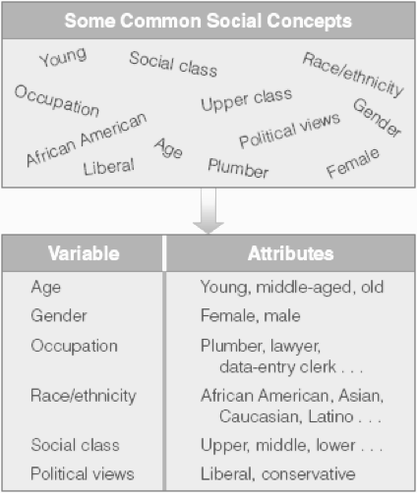
VARIABLES & ATTRIBUTES

Slide 22

DEPENDENT & INDEPENDENT VARIABLES
Dependent
The variable to be explained
The “effect”
The “Y” variable
The outcome
Independent
The variable expected to account for/explain the dependent variable
The presumed “cause”
The “X” variable
The predictor
VARIABLE TYPES
Notes:
Religiosity is a function of sex/gender? Which is DV? Which is IV?
Depending on the explanation, a variable might be a DV in one analysis, but and IV in the next (religiosity influencing crime).

Slide 23

DEPENDENT & INDEPENDENT VARIABLES
Dependent
The object of research. The thing you're trying to explain
Independent
The thing that influences the dependent variable
How do these differ?
The independent variable is often seen as influencing the dependent variable

Slide 24

Social scientists examine relationships between variables, across many observations, and develop explanations for these relationships
FOUNDATIONS OF EMPIRICAL SOCIAL SCIENCE
Notes:
Because social regularities represent probabilistic patterns, it doesn’t matter if the pattern isn’t reflected in 100% of observable cases. It doesn’t matter that despite men tending to make more money than women, some women make more than men. Social scientists ask WHY this is the case.

Slide 25
RELATIONSHIPS BETWEEEN VARIABLES
X
influence
Y
How does...
Independent
Dependent
HOW TO WRITE RESEARCH QUESTIONS
OR
Y
influenced by
X
How is...
Dependent
Independent

Slide 26
Social scientists examine relationships between variables, across many observations, and develop explanations for these relationships...
... by relying on theory and hypotheses
FOUNDATIONS OF EMPIRICAL SOCIAL SCIENCE
Notes:
Because social regularities represent probabilistic patterns, it doesn’t matter if the pattern isn’t reflected in 100% of observable cases. It doesn’t matter that despite men tending to make more money than women, some women make more than men. Social scientists ask WHY this is the case.

Slide 27
OBSERVATION
EXPLANATION

Slide 28
EXPLANATION
SOCIAL THEORY
Systematic explanations for the observations we see in society
Statement about why two or more variables (X and Y) are related
Based on prior literature
Sex (X) is related to earnings (Y), because...
Notes:
Social theory
Explanation for what is found, not with what should be
Is not concerned with what is “good” or “bad”

Slide 29
Types of Social Theory
INDUCTIVE
DEDUCTIVE
Theoretical argument developed from findings/observations. Then moves to literature
Theoretical argument based on premises/hypotheses derived from prior research, without findings/observations. Moves next to observations.

Slide 30
EXPLANATION
HYPOTHESIS
Specific statements about attributes within variables & their relationship
Testable statements about relationship between specific attributes within the two (or more) variables
Based on prior literature
Directional: Women (X category) earn less (Y category) than men
Non-Directional: Men and women (X categories) have different levels of earning (Y)
Notes:
Social theory
Explanation for what is found, not with what should be
Is not concerned with what is “good” or “bad”

Slide 31
Abortion attitudes are related to religiosity because of exposure to sermons about the “sanctity of life” in churches
THEORY
People who attend church regularly are more likely to oppose abortion than people who do not attend church regularly
HYPOTHESIS

Slide 32

FUNCTIONS AND TYPES OF SOCIAL RESEARCH
The purposes and ways of conducting empirical social science

Slide 33
FUNCTIONS OF SOCIAL RESEARCH
Exploratory Research
Mapping out a topic for further study
Googling or reading about a group/topic
Descriptive Research
Describes data collected
Exec reports on crime in cities, marijuana opinions
Explanatory Research
Explains why a social phenomenon occurs, uses data
Journal articles, uses data & theory

Slide 34
TYPES OF SOCIAL RESEARCH
Primary (Obtrusive) Observations
Participant
Observation
Focus Groups
Case Study
Interviews
Ethnography
Experiments
Surveys
Secondary (Unobtrusive) Observations
Secondary Data Analysis
Content/Text
Analysis
Case Study (Historical)

Slide 35
Types of Data (Observations)
QUALITATIVE DATA
QUANTITATIVE DATA
non-numerical data (e.g. text, conversations, correspondence)
numerical data (e.g. numbers used to represent some social phenomenon)

Slide 36
TYPES OF SOCIAL RESEARCH
Analysis of Qualitative Data
Participant
Observation
Focus Groups
Content/Text
Analysis
Case Study
Interviews
Ethnography
Analysis of Quantitative Data
Secondary Data Analysis
Content/Text
Analysis
Experiments
Surveys

Slide 37
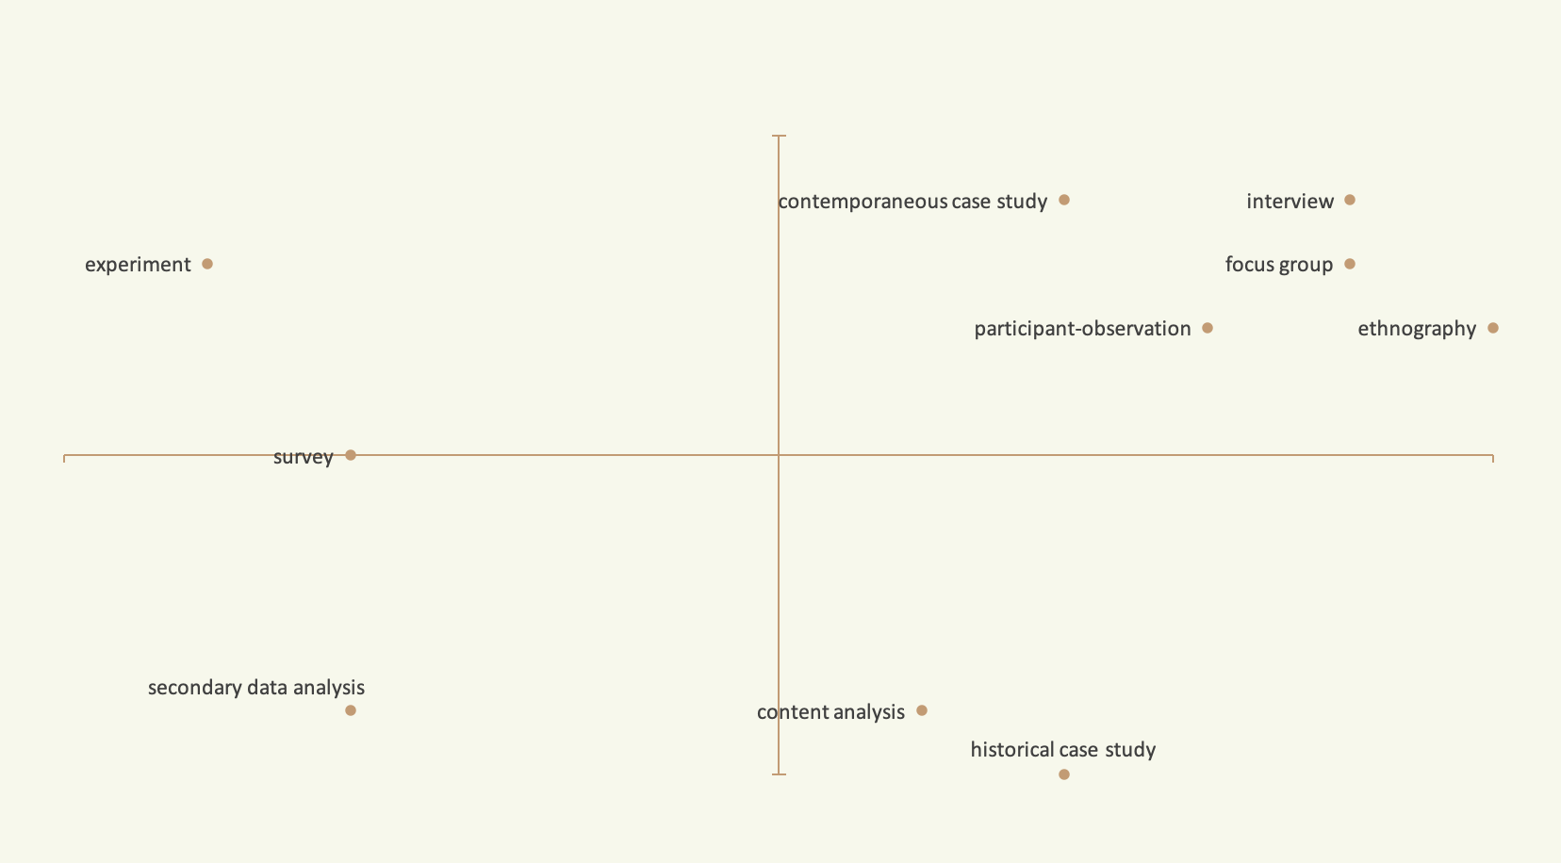
BREAKDOWN OF TYPES OF SOCIAL RESEARCH
Obtrusive
Quantitative
Qualitative
Unobtrusive

Slide 38
Types of Analysis
QUALITATIVE ANALYSIS
QUANTITATIVE ANALYSIS
search for meanings, search for patterns, themes, experiences, beliefs, attitudes amongst text data
search for statistical associations between numerically-measured variables

